Slide 1
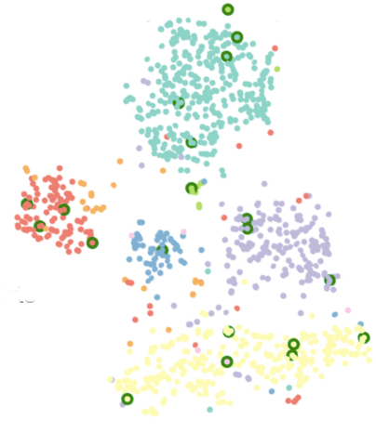
t-SNE

Slide 2
Outline
Review Dimensionality Reduction
Stochastic Neighbor Embedding (SNE)
t-Distributed Stochastic Neighbor Embedding (t-SNE)
Computational Complexity
Streaming t-SNE
Simulation Results

Slide 3
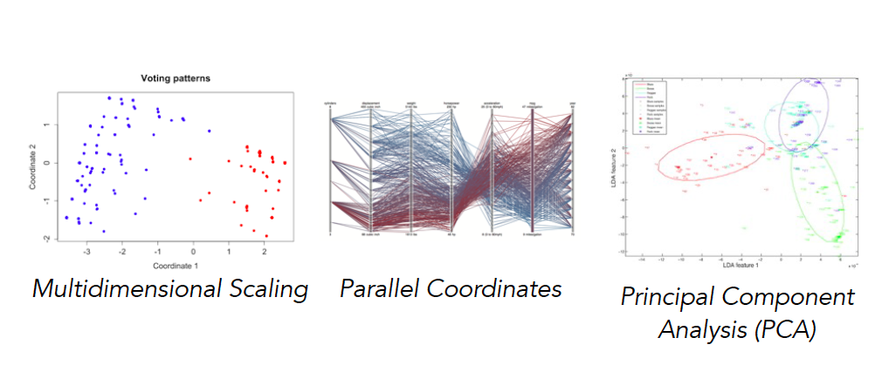
Visualizing many dimensions
Visualizing data of high dimension is hard!

Slide 4
Introduction
We are given a collection of N high-dimensional objects x₁, …, x_{n}
How can we visualize these objects in a low dimensional space?
Method
Build a 2-D or 3-D map, such that distances between points in the low-D map reflect similarities in the high-dimensional data.
We need to minimize an objective function that measures the discrepancy between similarities in the data and similarities in the map.
Notes:
We are given a set of N high dimensional objects
We would like to build a 2-D or 3-D map, where the distances between the points in this map reflect the similarities in the high-D data.

Slide 5
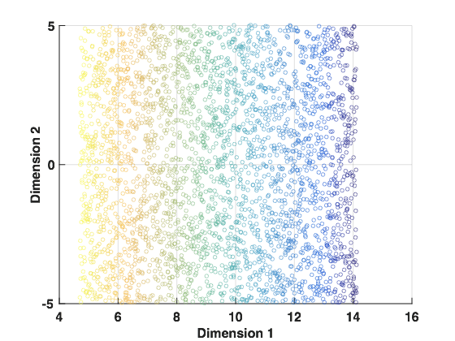
Example of Dimensionality Reduction
High Order Datapoints
Desired Low Dimensional Embedding
Notes:
One technique PCA. Take high–dimensional data . The variance of the data is reduced.

Slide 6
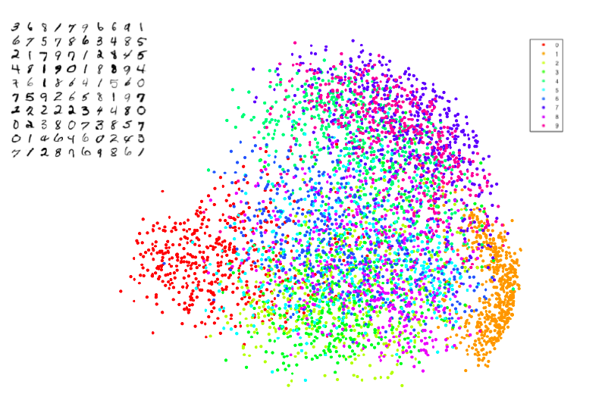
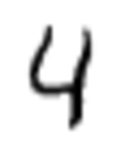
What about PCA?
(MNIST) Dataset of handwritten digits
Each datapoint is a 28x28 grayscale image
Can be viewed as a 784-dimensional point
1
.
.
.
784
28
28
Notes:
Here we have an example of the MNIST dataset, essentially images of handwritten digits.
Each image, is 28 x 28 pixels and represents a digit from 0-9. The image is flattened to a 1D vector representing all the pixels of the of the image.
On the right, is the visualization of the images in a 2D space. The colors represent the digits .
From this visualization, we can’t see any clusters

Slide 7
What distances to preserve?
PCA is concerned with preserving large pairwise distances in the map.
But are such distances very informative?
Points which are far apart in high-dimensional space would also appear far apart in low-dimensional subspace.
However, distances between similar points is not necessarily preserved.
Our goal is to generate a low-dimensional embedded such that points that are nearest neighbor in high-dimensional map, are also neighbors in low dimensional.
Notes:
- PCA finds low-dimensional subspace with maximal variance.
Hence, for visualizing high-dimensional data is that it only preserves large pairwise distances between the points. -- -
Meaning points which are far apart in high-dimensional space would also appear far apart in low-dimensional subspace but other than that all other pairwise distances would get screwed up.
So our goal is that, we generate a low-dimentional embedded such that points that are neigerst neighbor in high-dimentional map, are also neighbors in low dimentionall.

Slide 8
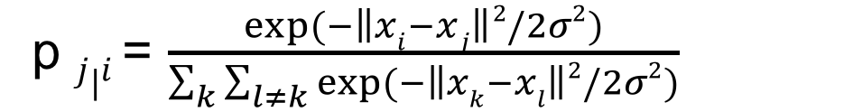
Stochastic Neighbor Embedding
Measure pairwise similarities between high-dimensional objects.
If the two datapoints x_{i} and x_{j} are relatively
close to one another, the similarity should be high.
p $j|i$ = $\frac{exp⁡(−\left\|xi−xj\right\|2/2σ2)}{\sum_{k}{\sum_{l≠k}{exp⁡(−\left\|xk−xl\right\|}2/2σ2)}}$
Notes:
In the high dimensional space, we take our object x_j. We will center a Gaussian on this object.
We will measure the density of the other points (x_j) under the Gaussian.
Points that are similar to x_i, we will get a value between 0 and 1.
Points that are dis-similar to x_i, infinitdesimal value
Divide by the sum of all these densities.
Give us the probability or distribution over pairs of points.
Give us a probability of picking a pair of points, is proportional to how similar these points are.
We don’t normalize over all pairs of points, just those points of xi.
We set the bandwidth 𝜎 such that the conditional has a fixed perplexity, in other words, we set the a fixed number of points under each guassian.

Slide 9
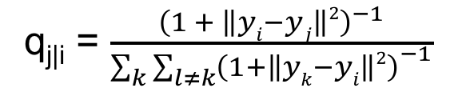
Stochastic Neighbor Embedding
Measure pairwise similarities between low-dimensional map points.
q_{j|i} = $\frac{{\left(1 + \left\|yi−yj\right\|2\right)}^{−1}}{{\sum_{k}{\sum_{l≠k}{\left(1+\left\|yk−yi\right\|2\right)}}}^{−1}}$
Notes:
Now, we will look at the low-dimensional space.
For each point y_i, we will center a Guassian over the point. And measure the denisity of all other opoints Y_j
We will do the same normizlation, by diviing over the sump of the densitites.
So, we end-up with a probability q_ij

Slide 10
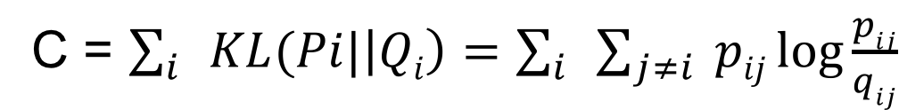

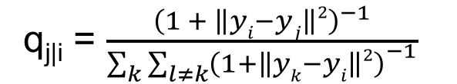
Stochastic Neighbor Embedding (SNE)
Converting the high-dimensional Euclidean distances into conditional probabilities that represent similarities.
Similarity of data-points in High Dimension
Similarity of data-points in Low Dimension
Cost function
p $j|i$ = $\frac{exp⁡(−\left\|xi−xj\right\|2/2σ2)}{\sum_{k}{\sum_{l≠k}{exp⁡(−\left\|xk−xl\right\|}2/2σ2)}}$
q_{j|i} = $\frac{{\left(1 + \left\|yi−yj\right\|2\right)}^{−1}}{{\sum_{k}{\sum_{l≠k}{\left(1+\left\|yk−yi\right\|2\right)}}}^{−1}}$
C = $\sum_{i}{KL(Pi|\left|Qi\right)=}$ $\sum_{i}{\sum_{j≠i}{ pij\log{\frac{pij}{qij}}}}$
Minimize the cost function using gradient descent
Stochastic Neighbor Embedding by Hinton & Roweis (2012)
Notes:
The KL divergence measures the discrepancy between the two distributions…. Or “distance” between two distributions
Large pij modeled by small qij ? Big penalty
Small pij modeled by large qij? Not so big penalty
SNE mainly preserves local similarity structure of the data

Slide 11
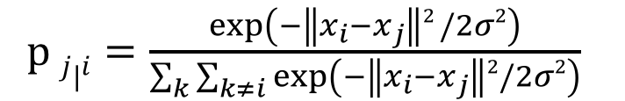
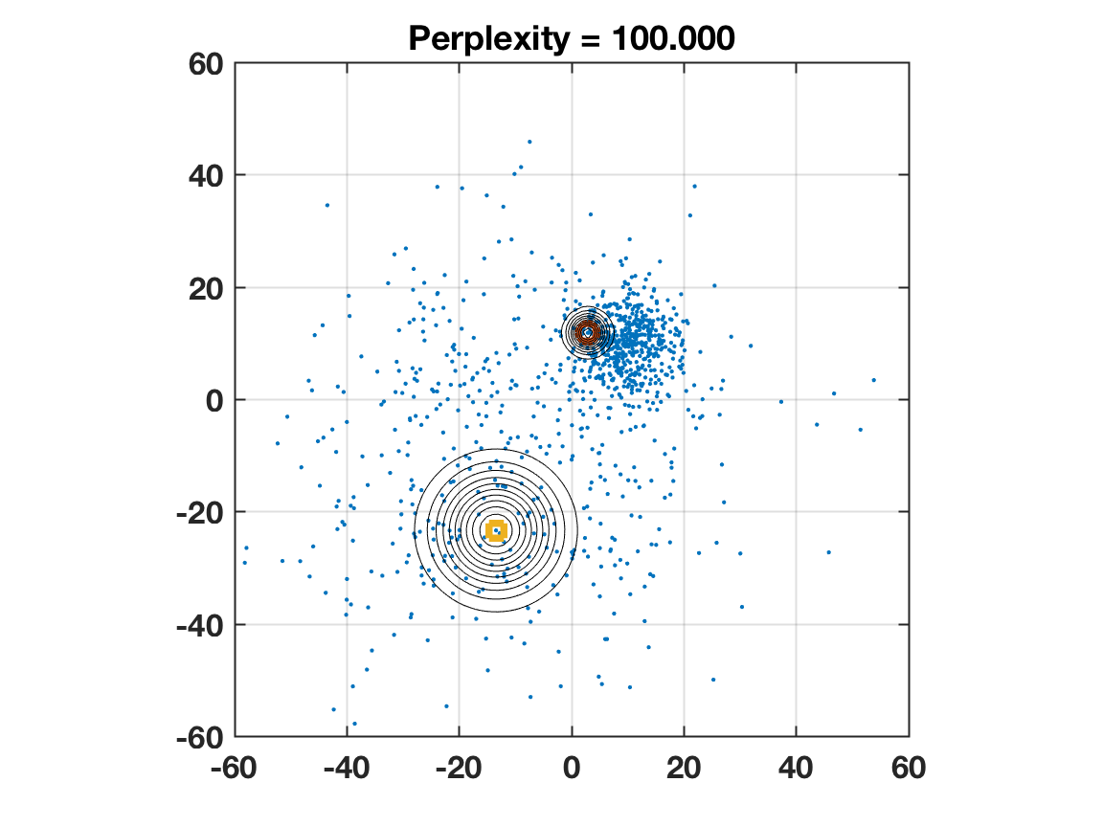
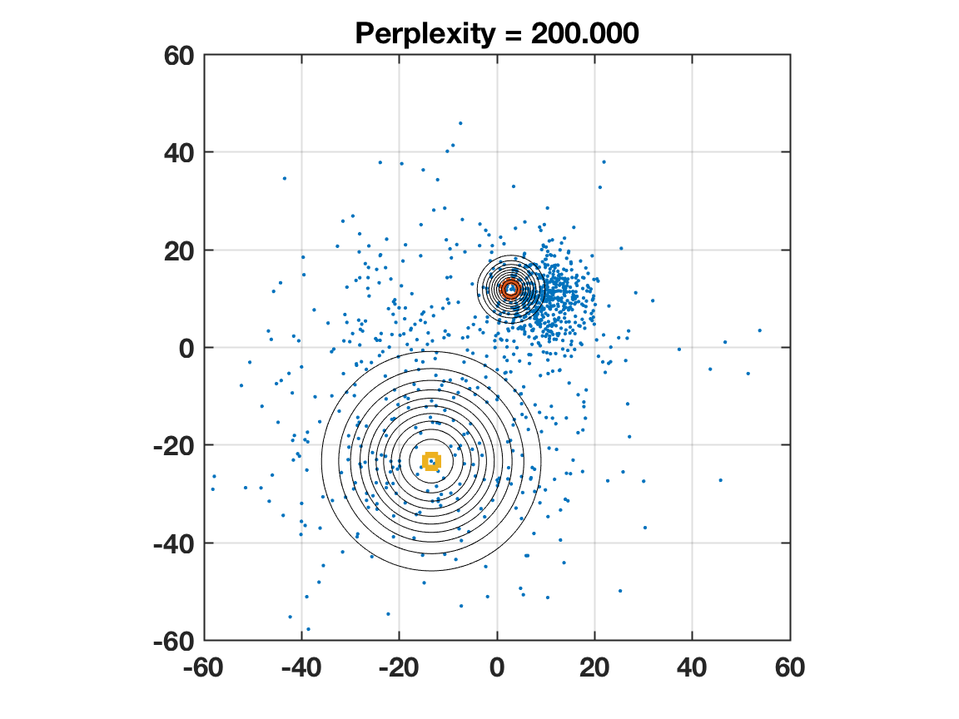
How to choose sigma?
Set the bandwidth such that the conditional has a fixed perplexity.

Slide 12
Issues with SNE
SNE suffers from the crowding problem
Suppose data is very high – dimensional
If we try to model the local structure of this data in the map
The result is that dissimilar points have to be modeled too far part in the map
Hence, most visualizations will display a group of points clustered in the middle.

Slide 13
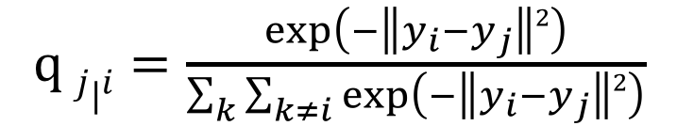
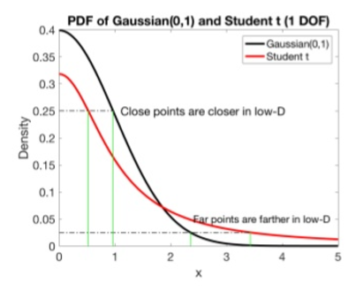
t-Distributed Stochastic Neighbor Embedding
Use a heavy-tailed distribution to measure similarities in the map:
As a result, dissimilar objects are allowed to be modeled too far apart.
This effectively eliminates the crowding problem.

Slide 14
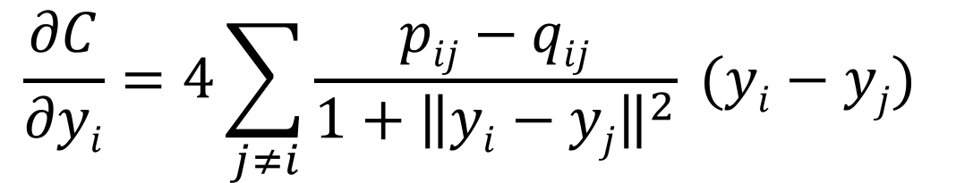
Gradient interpretation
We can interpret the t-SNE gradient as a simulation of an N-body system:
$$\frac{∂C}{∂yi}=4\sum_{j≠i}{\frac{pij−qij}{{1+\left\|yi−yj\right\|}^{2}} (yi−yj) }$$
B
D
E
A
C
F
G
H
I
Notes:
How to move a simple y_{i} in the map, to get a lower KL divergence
Take this form, a spring between a pair of points (c and f)
And the other term is the exertion /compression between the other terms
The sum taking all forces acting on this point, and we want compute a resulting force
We need to consider all pair-wise interaction between points
So, we use an approximation that will lower the complexity to O(n log n)

Slide 15
Barnes-Hut t-SNE
Original t-SNE data and computational complexity is O(N²)
Limits visualization to thousands of points
Observation : Many of the pairwise interactions between points are very similar
Idea: Approximate similar interactions by a single interaction
If a collection of k points are sufficiently away from x_{i}
Then approximate the force excreted by those points as f * k
Reduce complexity to O ( N * log (N)) via Barnes-Hut t-SNE
Allows t-SNE to scale to millions of data points
Utilizes a tree - based algorithm (vantage-point trees) to perform the KNN search
Accelerating t-SNE using Tree-Based Algorithms by Maaten and Hinton (2014)
Notes:
To calculate the net force on a particular body, the nodes of the tree are traversed, starting from the root. If the center of mass of an internal node is sufficiently far from the body, the bodies contained in that part of the tree are treated as a single particle whose position and mass is respectively the center of mass and total mass of the internal node. If the internal node is sufficiently close to the body, the process is repeated for each of its children.
Take the center of mass of the far away points, and multiple that by the number of points … astronomy

Slide 16
Quadtree
In practice, application of Barnes-Hut optimization is performed using a tree.
In the low-dimension, we implement this using a Quadtree.
( centerOfMass , numOfPoints)
A
D
B
C
E
…
A
B
C
D
E
F
G
H
I
F
G
I
H
Notes:
Quadtrees is a data structure used to partition a 2D space into quadrants.
The tree is continually divided into quadrants, until we have 1 point per quadrant.
To search for a point, we start at the root

Slide 17

Quadtree
$$\frac{r_{cell}}{\left\|y_{i}−y_{cell}\right\|2}<θ$$
B
A
D
C
E
…
A
B
C
D
E
F
G
H
I
F
G
I
H
Notes:
Quadtrees is a data structure used to partition a 2D space into quadrants.
The tree is continually divided into quadrants, until we have 1 point per quadrant.
To compute the force acting upon node I, we would traverse the tree. At each node, compute whether the node can be used as a “summary” .
If the node satisfies the summary condition, the force between the center-of-mass of the three points and point I is computed, * number of points in the cell.

Slide 18
Barnes Hut Approximation
…
…
…
…
(a) High – Dimensional Feature Vectors
(b) K-nearest neighbor graph (KNN)
(c) 2 – dimensional layouts

Slide 19
Issues with t-SNE
t-SNE only works in batch mode
Assumes all points are known up-front
To add new points, need to re-run t-SNE
Tree structures don’t scale for high dimensions
Vantage-Point (VP) Tree are used to represent high-dimensional data
VP Trees do not scale for dimensions > 10

Slide 20
Streaming t-SNE
Extend t-SNE to support the following operations, for a given state:
insert (point)
add a new data point to a state
update_neighborhood (point)
recompute a point’s neighborhood ( based on number and distances of nearby points)
remove (point)
Drop a point from the state
update ()
perform one step of gradient descent optimization

Slide 21


Batch t-SNE algorithm
State of the t-SNE algorithm will be managed in data structure
def batch_process (X) :
state = TSNEState ( $μ$ , T , $θ$)
# populate state with data
for point in X:
state.insert ( point )
# compute all neighborhoods
for point in X:
state.update_neighborhood ( point )
# gradient descent
for t =0 to T:
state.update()
return state
Parameters:
$μ$ - perplexity
T – number of iterations
$θ −$ degree of approximation in Barnes-Hut

Slide 22


Batch t-SNE algorithm
state of the t-SNE algorithm will be managed in data structure
def stream_process (X) :
state = TSNEState ( $μ$ , T , $θ$)
# main processing loop
while stream_has_data () :
point = next_point ()
state.insert ( point )
state.update_neighborhood (point)
state.update()
Parameters:
$μ$ - perplexity
T – number of iterations
$θ −$ degree of approximation in Barnes-Hut
For simplicity, we assume one point is being inserted at each iteration, but inserting more points per iteration is possible.

Slide 23
Streaming t-SNE Demo
Original t-SNE is batch based, hence requires all data points up-front.
Can we lift this restriction?
We propose a streaming t-SNE that supports
sliding window evaluation over a dataset
visualizing an evolving distribution in near real-time

